Slide 1
MRL Plating Sector Reports
Chris Guarino
Adele Pacquette
Eugene O’Sullivan
March 3, 2022
Notes:
Hello and welcome

Slide 2
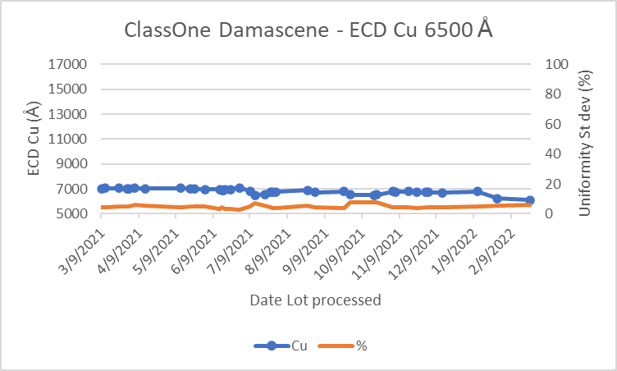
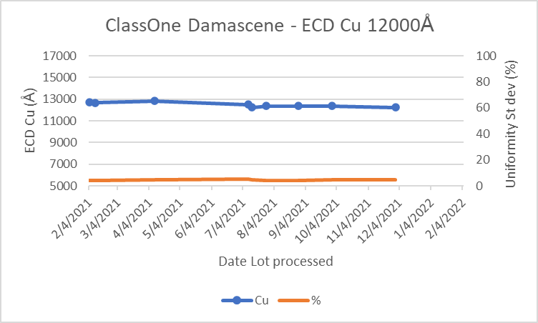
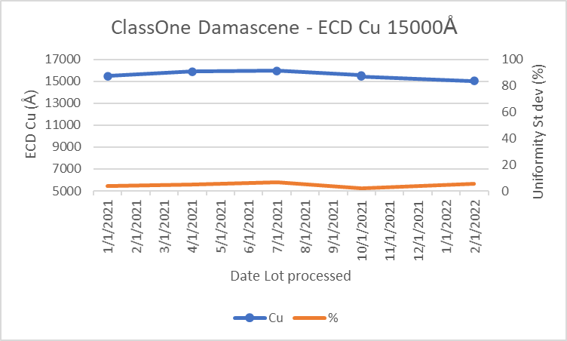
ClassOne Damascene - Cu Fresh chemistry installed every quarter. (24L) Bath analysis is used to check additives weekly. Additions of additives made to bring bath into spec. Tool qual blanket seed 680A Cu wafer processed prior to processing each lot. Sheet resistance and thickness measured on RS75 tool (spec st. dev < 10 %).
IBM Confidential

Slide 3
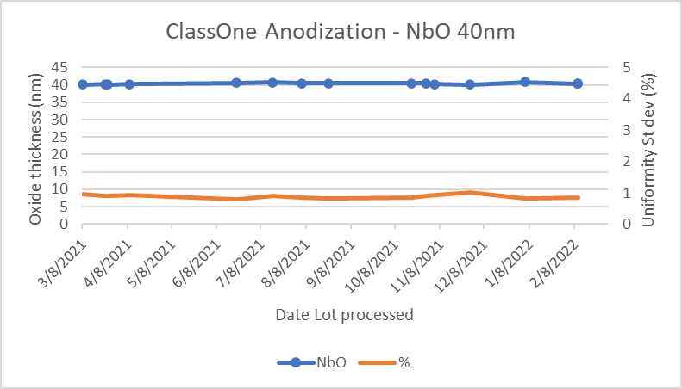
ClassOne Anodization - NbO Fresh chemistry installed prior to processing each Quantum anodization lot. Specifications 40nm oxide (NbO). Tool qual blanket Nb wafer processed prior to processing each Quantum anodization lot. Oxide thickness measured on UV1280 tool (spec st. dev < 1 %).
IBM Confidential

Slide 4
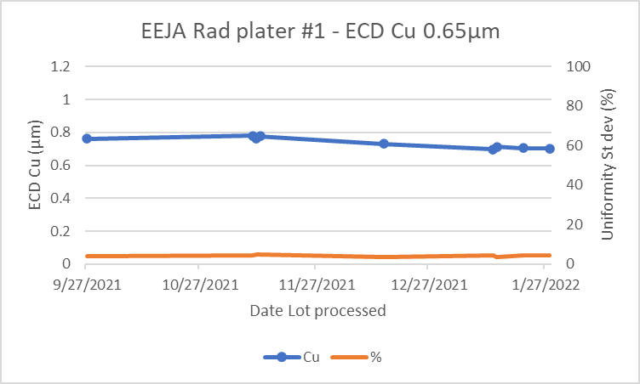
EEJA Rad plater - Cu Fresh chemistry installed every month. No chemistry on tool when IDLE. Bath analysis to check additives before processing each ASPCM lot. Additions of additives made to bring bath into spec. Tool qual blanket Cu wafer processed prior to processing each ASPCM lot. Sheet resistance and thickness measured on CDE Resmap tool (spec st. dev < 5 %).
IBM Confidential

Slide 5
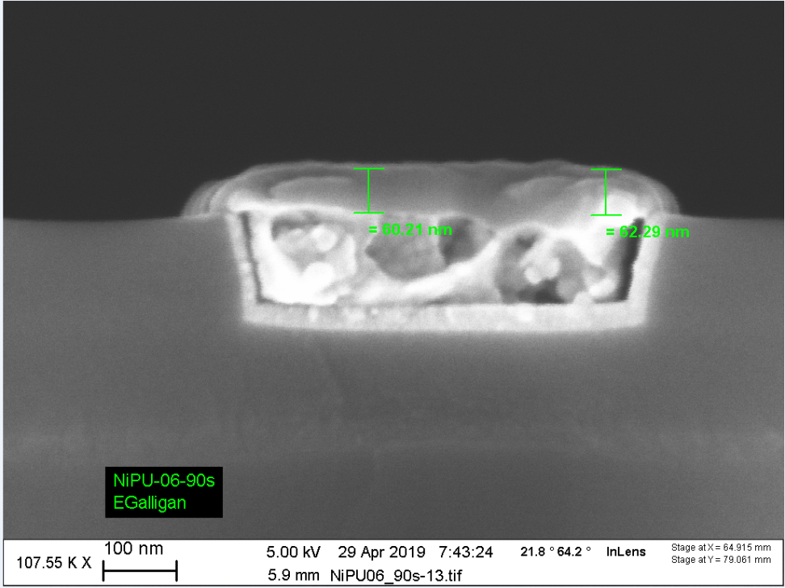
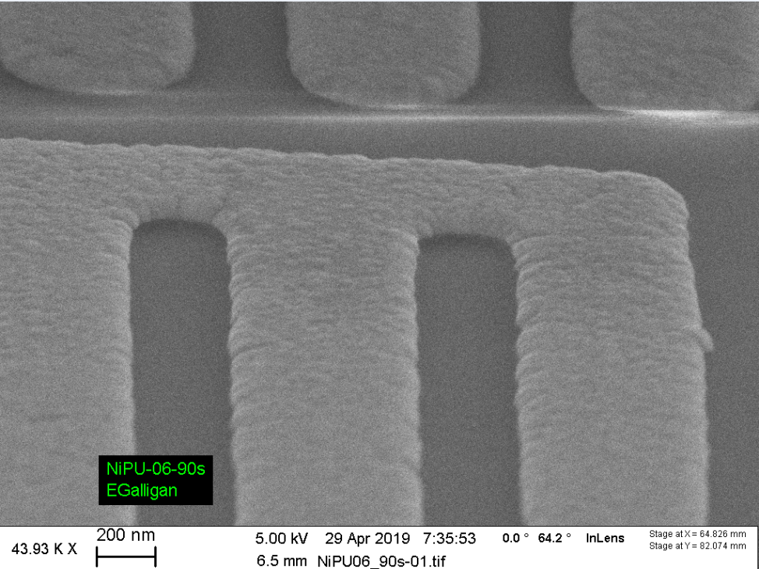
Nickel Phosphorous Electroless Plating – Ni(P) Fresh chemistry is made approximately after every 6 consecutive lot runs. Qualifying a bath’s efficacy involves running a 3 x 3 mm 0.65um Cu coupon through the entire plating procedure with a set Ni(P) plating time of 10 minutes. We calculate plating times and rates for product runs based on the mass differential PRE and POST. -
Ni(P) thickness: ca. 60 nm
Ni(P)
Ni(P)
Cu

Slide 7
Excellent Selectivity
Excellent Selectivity
65 – 70 nm Ni(P) thickness
Cu
Notes:
- Due to this being a maskless process inspections are the most important tool we have in tracking how stable the Nickel Phosphorous process is over time.
- Regardless of how our plating rates trend, this process is a highly selective deposition and our meticulous inspections are what give us the clearest indication of wafer to wafer success and stability.

Slide 8
SPC Ni(P) Electroless Qualifiers MASS (10 min)
Notes:
Once the wafer is submerged in plating bath there is a pre-plating induction time that can change from run to run. This results in perceived plating rate changes which seem to currently be trending in a positive slope. This shifting pre-plating induction time could be due to a hundred different variables, such as the incoming Cu history, Cu surface state, minor changes to the manufacture’s proprietary solution we use to make the bath, etc…
- Emphasis on inspection driven processing is common in the CMP/Plating group for all programs. This is made easier by having an excellent microscope and camera system such as the Olympus LEXT OLS5000 which our group gained in 2020.

